Slide 1
Data Modeling Using the Entity-Relationship (ER) Model (Continuation)
Dr. Anand Kumar M
Assistant Professor,
NIT-K, Surathkal

Slide 2
Notation for Constraints on Relationships
Cardinality ratio (of a binary relationship): 1:1, 1:N, N:1, and M:N
Shown by placing appropriate numbers on the relationship edges.
Participation constraint (on each participating entity type): total (called existence dependency) or partial.
Total shown by double line, partial by single line.

Slide 3
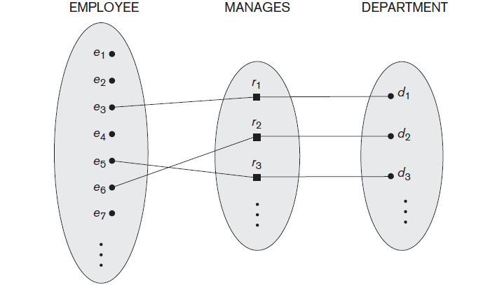
One-to-one (1:1) Relationship

Slide 4
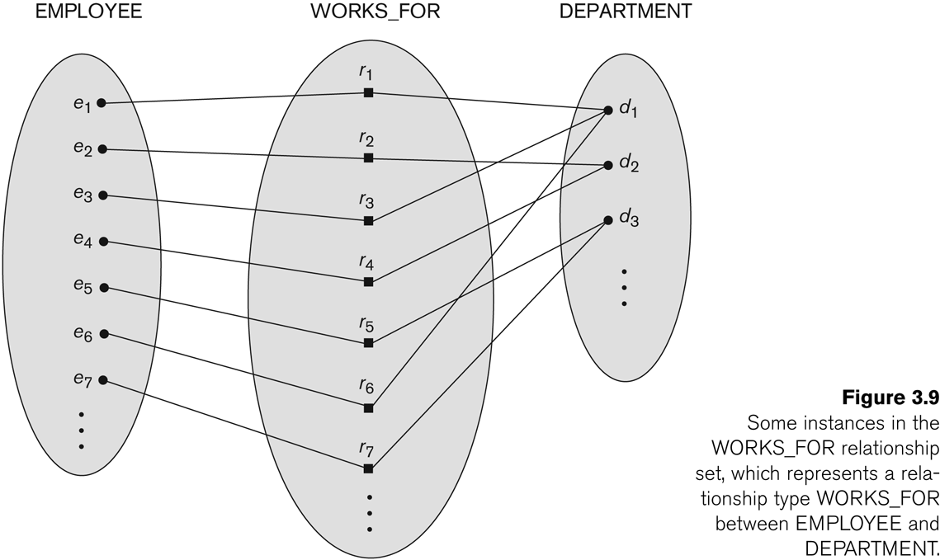
Many-to-one (N:1) Relationship

Slide 5
Many-to-one (N:1) Relationship

Slide 6
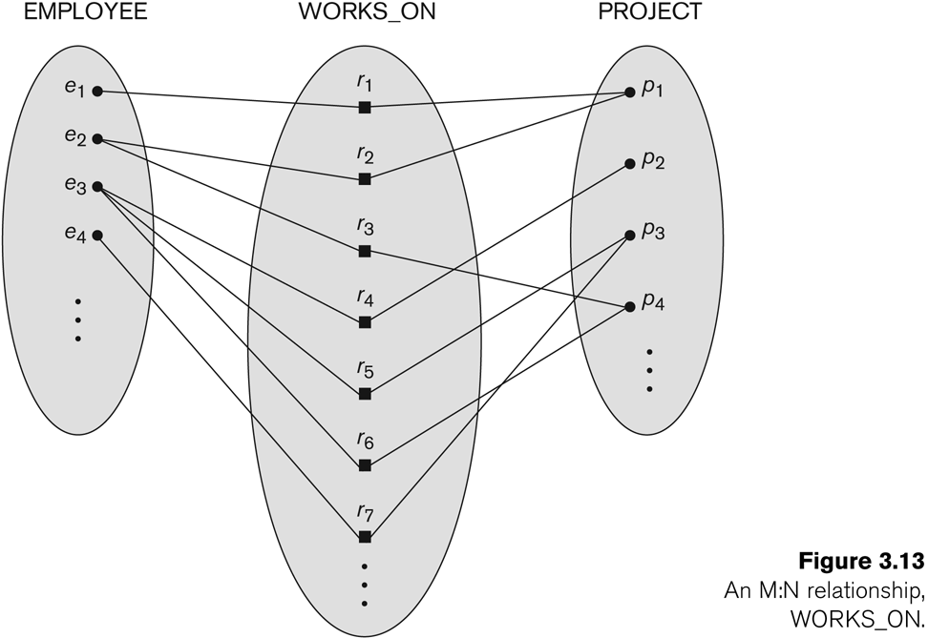
Many-to-many (M:N) Relationship

Slide 7
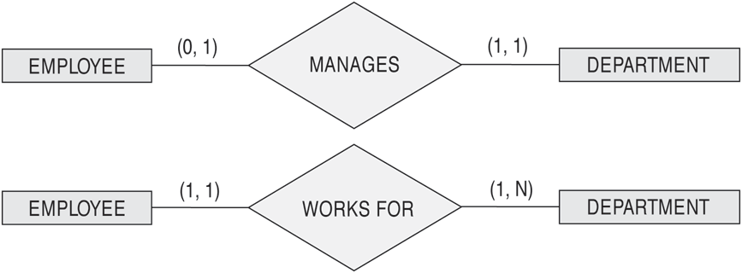
The (min,max) notation for relationship constraints
Read the min,max numbers next to the entity type and looking away from the entity type

Slide 8
Alternative (min, max) notation for relationship structural constraints:
Specified on each participation of an entity type E in a relationship type R
Specifies that each entity e in E participates in at least min and at most max relationship instances in R
Default(no constraint): min=0, max=n (signifying no limit)
Must have min≤max, min≥0, max ≥1
Derived from the knowledge of mini-world constraints
Examples:
A department has exactly one manager and an employee can manage at most one department.
Specify (0,1) for participation of EMPLOYEE in MANAGES
Specify (1,1) for participation of DEPARTMENT in MANAGES
An employee can work for exactly one department but a department can have any number of employees.
Specify (1,1) for participation of EMPLOYEE in WORKS_FOR
Specify (1,n) for participation of DEPARTMENT in WORKS_FOR

Slide 9
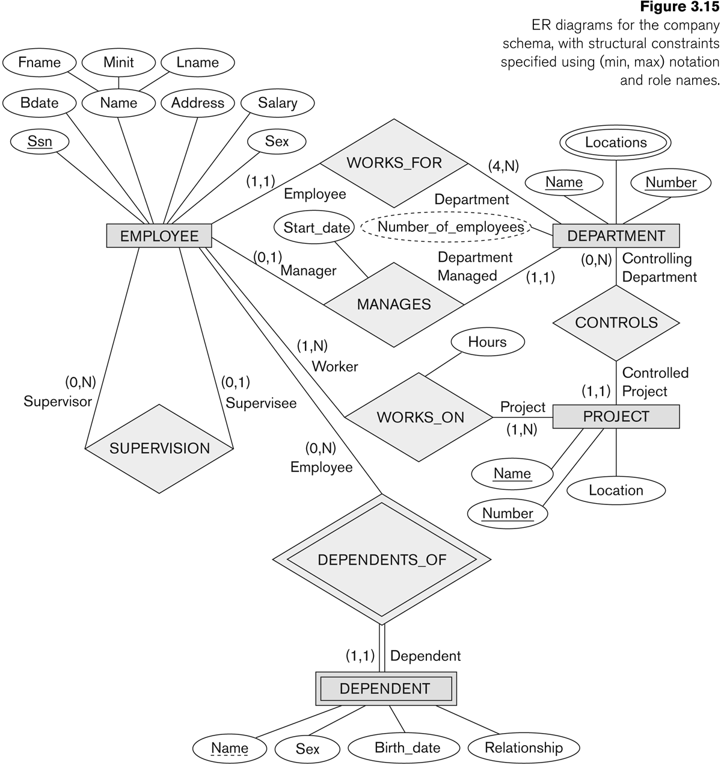
COMPANY ER Schema Diagram using (min, max) notation

Slide 10
Alternative diagrammatic notation
ER diagrams is one popular example for displaying database schemas
Many other notations exist in the literature and in various database design and modeling tools
UML class diagrams is representative of another way of displaying ER concepts that is used in several commercial design tools

Slide 11
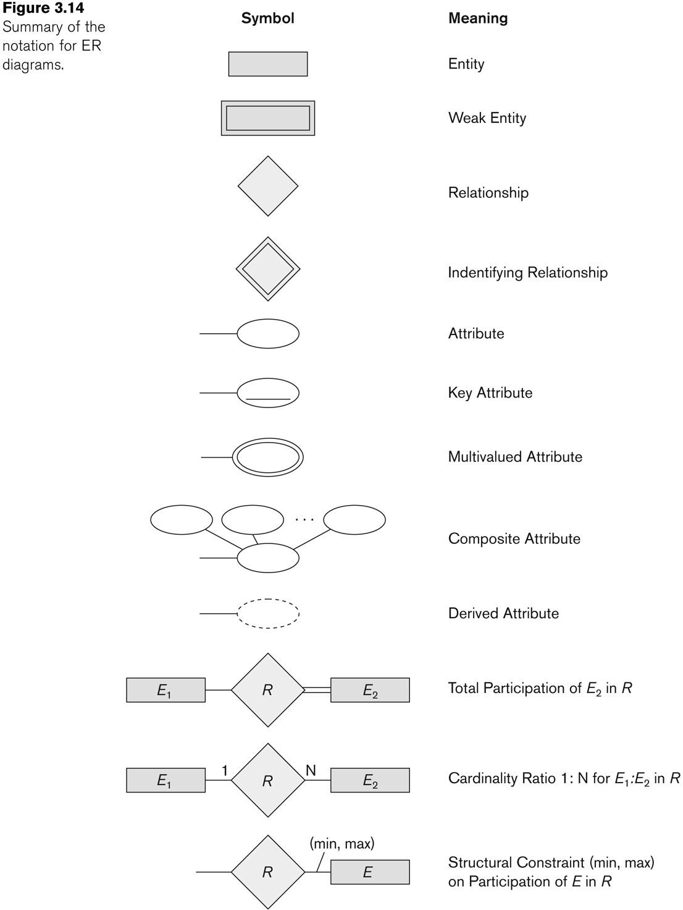
Summary of notation for ER diagrams

Slide 12
UML class diagrams
Represent classes (similar to entity types) as large rounded boxes with three sections:
Top section includes entity type (class) name
Second section includes attributes
Third section includes class operations (operations are not in basic ER model)
Relationships (called associations) represented as lines connecting the classes
Other UML terminology also differs from ER terminology
Used in database design and object-oriented software design
UML has many other types of diagrams for software design

Slide 13
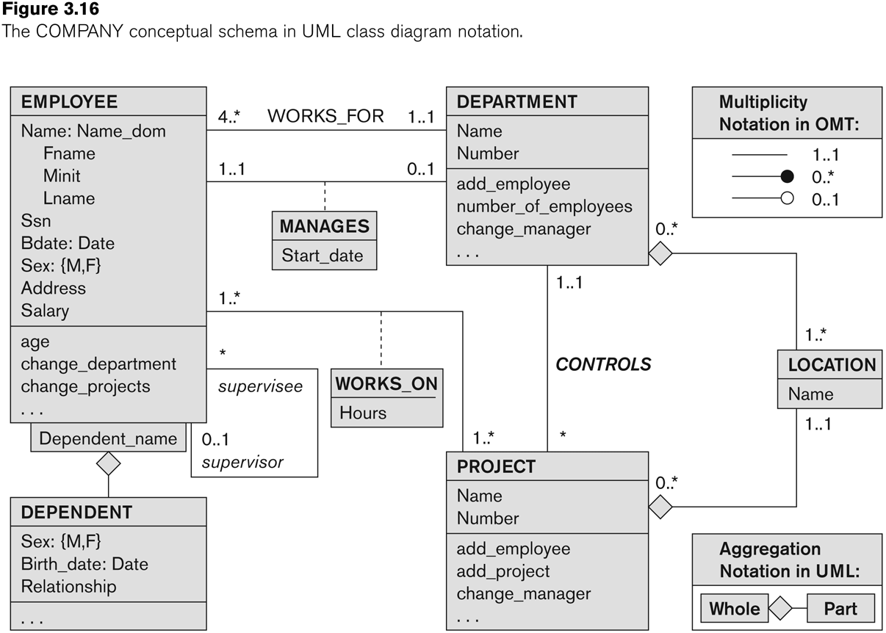
UML class diagram for COMPANY database schema

Slide 14
 | Entity 1 | Cardinality Ratio | Entity 2
1. | Student |  | SocialSecurityCard
2. | Student |  | Teacher
3. | ClassRoom |  | Wall
4. | Country |  | CurrentPresident
5. | Course |  | TextBook
6. | Item (that can be found in an order) |  | Order
7. | Student |  | Class
8. | Class |  | Instructor
9. | Instructor |  | Office
10. | E-bay Auction item |  | E-bay bid

Slide 15
 | Entity 1 | Cardinality Ratio | Entity 2
1. | Student | 1-1 | SocialSecurityCard
2. | Student | Many-many | Teacher
3. | ClassRoom | Many-many | Wall
4. | Country | 1-1 | CurrentPresident
5. | Course | Many-many | TextBook
6. | Item (that can be found in an order) | Many-many | Order
7. | Student | Many-many | Class
8. | Class | Many-to-1 | Instructor
9. | Instructor | 1-1 | Office
10. | E-bay Auction item | 1-many | E-bay bid

Slide 16
ER/Data modeling tools
Erdplus
ERstudio-big data platforms such as MongoDB and Hadoop Hive
Oracle SQL Developer Data Modeler
SQLDBM
Dezign
AquaData Studio ER Modeler

Slide 17
Data Modeling Trends
The growth of Big Data and its unstructured and semi-structured data formats..
Unstructured data can be best tackled via Artificial Intelligence (AI), self-describing data formats, and ontological models.
NoSQL-non relational-handling large amounts of unstructured data.
Database/data analysts demand Predictive Models, which are incorporated only via Artificial Intelligence or Machine Learning technologies.
Semantic Data Models

Slide 18
Recent Research Topics..
Business Intelligence and Analytics.
Requirements Engineering
Applications to Bioinformatics, Cyber Security, and Privacy
Role of Conceptual Modeling in Social Networks, Mobile Computing, Deep Learning, Internet of Objects.

Slide 19
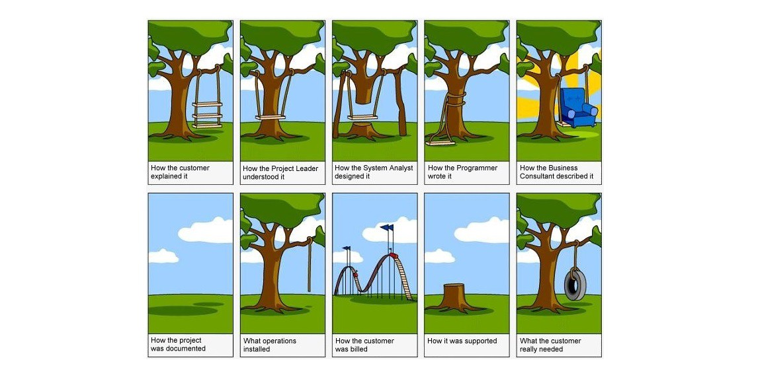

Slide 20
Thank You

